Slide 1
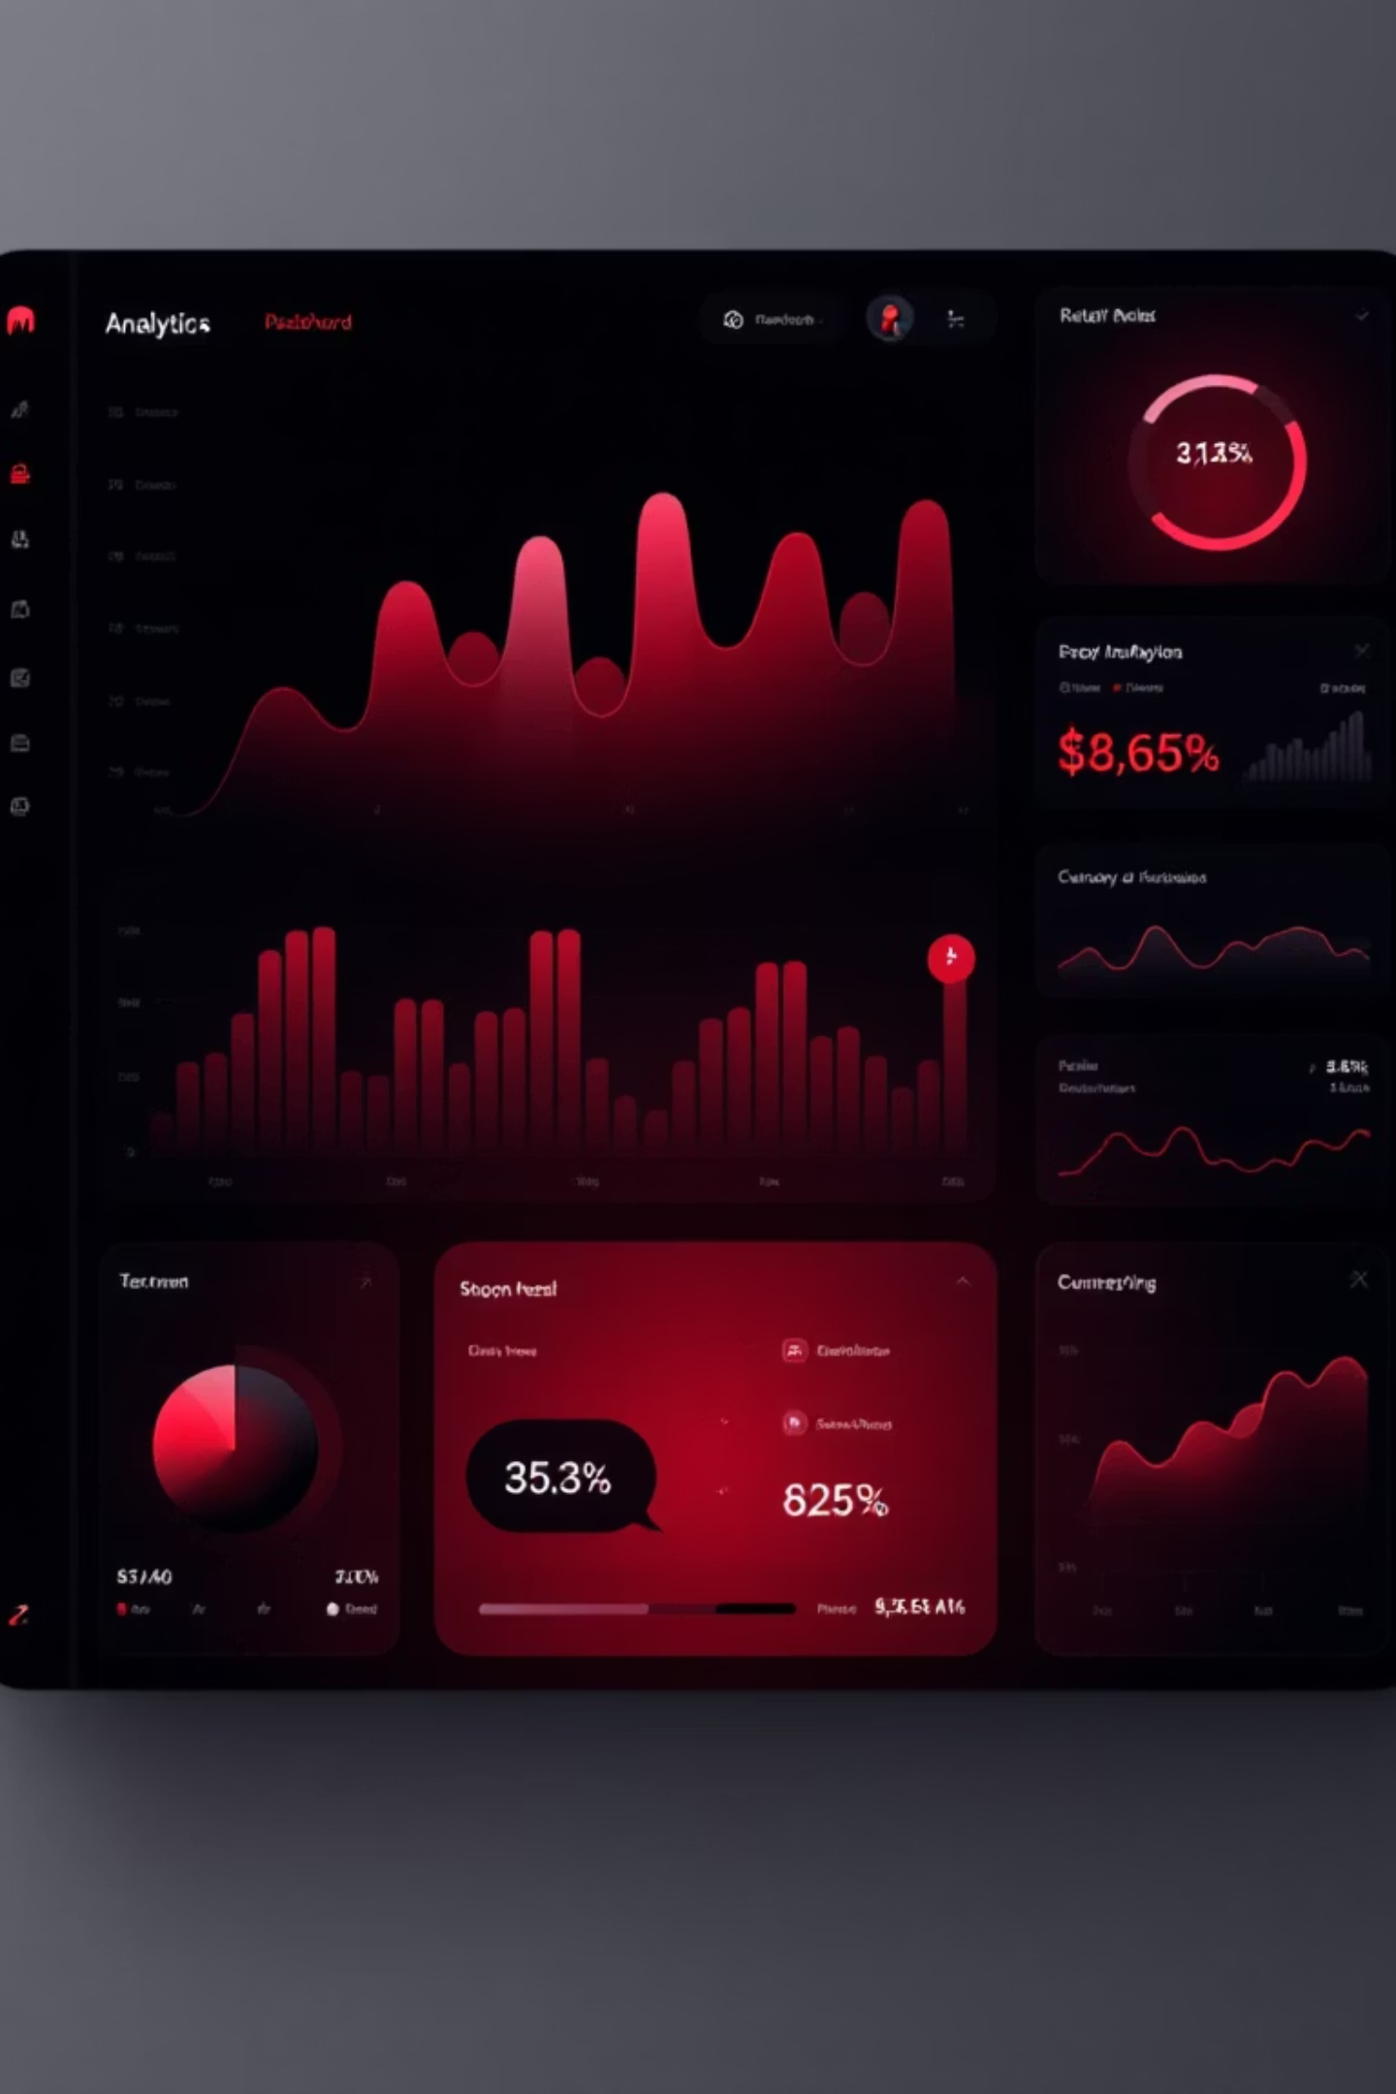
Customer Shopping Behavior Analysis
Uncovering insights from 3,900 purchases to drive strategic business decisions

Slide 2

Dataset at a Glance
3,900
18
$59.76
Total Purchases
Data Points
Avg Purchase
Features per customer
Per transaction
Transactions analyzed
3.75
Avg Rating
Customer satisfaction

Slide 3

Data Preparation Journey
01
Data Loading & Exploration
Imported dataset, checked structure with pandas
02
Missing Data Handling
Imputed 37 missing review ratings using category medians
03
Feature Engineering
Created age groups and purchase frequency metrics
04
Database Integration
Connected to PostgreSQL for advanced analysis

Slide 4

Revenue Insights
Gender Revenue Split
Shipping Preferences
Male customers generate $157,890 vs Female $75,191
Express: $60.48 avg
Standard: $58.46 avg
Male shoppers drive 68% of total revenue
Premium shipping correlates with higher spend

Slide 5




Customer Segmentation
Returning
701 customers
18% showing repeat behavior
Loyal
3,116 customers
80% of customer base
New
83 customers
2% first-time buyers

Slide 6
Subscription Analysis
Subscription Rate
Spending Patterns
Repeat Buyers
27% subscribed
Subscribers: $59.49 avg
958 subscribers with 5+ purchases
73% non-subscribers
Non-subscribers: $59.87 avg
2,518 non-subscribers
Opportunity: Convert high-frequency buyers to subscribers

Slide 7
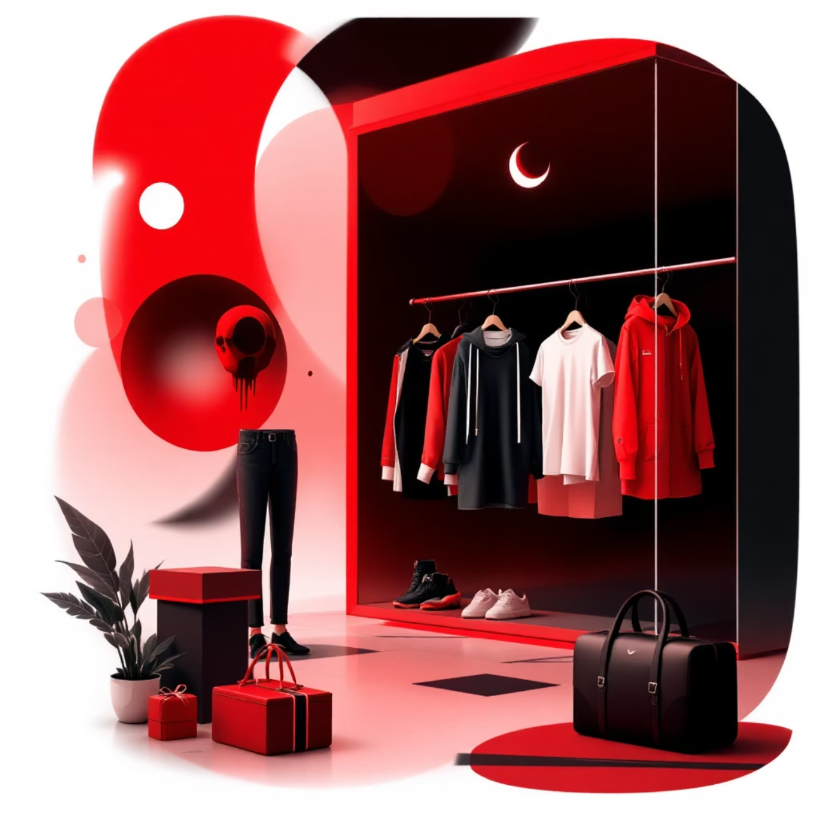
Product Performance
Top-Rated Products
Gloves - 3.86 rating
Sandals - 3.84 rating
Boots - 3.82 rating
Hat - 3.80 rating
Skirt - 3.78 rating
Discount-Dependent Items
Hat: 50% discounted
Sneakers: 49.66%
Coat: 49.07%

Slide 8
Category Revenue Breakdown
43%
21%
Clothing
Accessories
Largest revenue driver at $100K
Strong performer at $50K
4%
2%
Footwear
Outerwear
Growing segment at $10K
Seasonal opportunity at $5K

Slide 9
Age Group Insights
Young Adult
Middle-aged
$62,143 revenue
$59,197 revenue
Highest spending group
Consistent buyers
Adult
Senior
$55,978 revenue
$55,763 revenue
Stable segment
Untapped potential

Slide 10
Strategic Recommendations
Boost Subscriptions
Loyalty Programs
Review Discount Policy
Promote exclusive benefits to convert high-frequency buyers
Reward repeat buyers to strengthen "Loyal" segment
Balance sales growth with margin control on discount-dependent products
Product Positioning
Targeted Marketing
Highlight top-rated items in marketing campaigns
Focus on young adults and express-shipping users for maximum ROI

